Slide 1






School of Computer Science and Engineering
Department of Computer Engineering and Technology
Second Year B. Tech. CSE (Cybersecurity and Forensics)
CSF20060: Project Based Learning-I A.Y. 2025-26 Semester: III Panel: A Batch: A2
Mini Project Presentation Title: Encryption Using Steganography
Group Id: ****
Shreyas Newe - 1262241387
Sreeraj Rajeevan - 1262241335
Adwait Bhalerao - 1262241696
Project Guide:
Dr. Vinayak Musale

Slide 2

Image Steganography using LSB Method
This project explores the technique of invisibly hiding secret messages within digital images using the Least Significant Bit (LSB) method. It features a dual implementation approach, leveraging both Python for flexibility and C++ for optimized performance.
Prepared and Presented By
Shreyas Newe - 1262241387

Slide 3


Introduction
Steganography is a technique for concealing secret information within ordinary media, making the very existence of the communication hidden. Unlike encryption, which scrambles data, steganography focuses on invisibility.
Our project specifically utilizes Least Significant Bit (LSB) image steganography, where messages are embedded into the least significant bits of image pixels. This method ensures that the changes are virtually invisible and undetectable to the human eye.
The implementation combines Python for handling the core logic and C++ for performance optimization and precise bit manipulation, allowing for efficient and robust hidden message embedding.
Prepared and Presented By
Shreyas Newe - 1262241387

Slide 4


Problem Statement
Data Vulnerability
Encryption Drawbacks
Covert Communication Need
Sensitive data is easily intercepted on public networks.
Encryption signals valuable data, attracting unwanted attention.
Security needs methods that conceal data's very existence.
Our Objective:
Develop a robust LSB image steganography system.
Embed secret data invisibly within digital images.
Utilize C++ for optimal bit control and Python for accessibility.
Prepared and Presented By
Shreyas Newe - 1262241387

Slide 5

Project Objectives
01
Message Embedding
Hide secret text within digital images (LSB substitution).
02
Message Extraction
Reliably decode hidden messages without data loss.
03
Dual-Language Implementation
C++ for bit-level control; Python for UI/automation.
04
Visual Integrity
Ensure minimal image distortion; avoid detection.
Prepared and Presented By
Shreyas Newe - 1262241387

Slide 6

Literature Review
Key Steganographic Concepts
LSB Substitution: An elegant method modifying least significant bits for statistically imperceptible changes.
Visual Integrity: Ensures minimal image distortion, avoiding detection.
Hybrid C++/Python Approach: Leverages C++ for superior execution speed and granular bit-level control.
Python for Automation: Handles higher-level UI and workflow automation for ease of use.
Comparison of Steganographic Methods
Method
Perceptibility
Robustness
Capacity
LSB Substitution
High (low detectability)
Low (fragile)
Medium to High
Transform Domain
High
Medium to High
Medium
Spread Spectrum
High
High
Low
Prepared and Presented By
Sreeraj Rajeevan - 1262241335

Slide 7
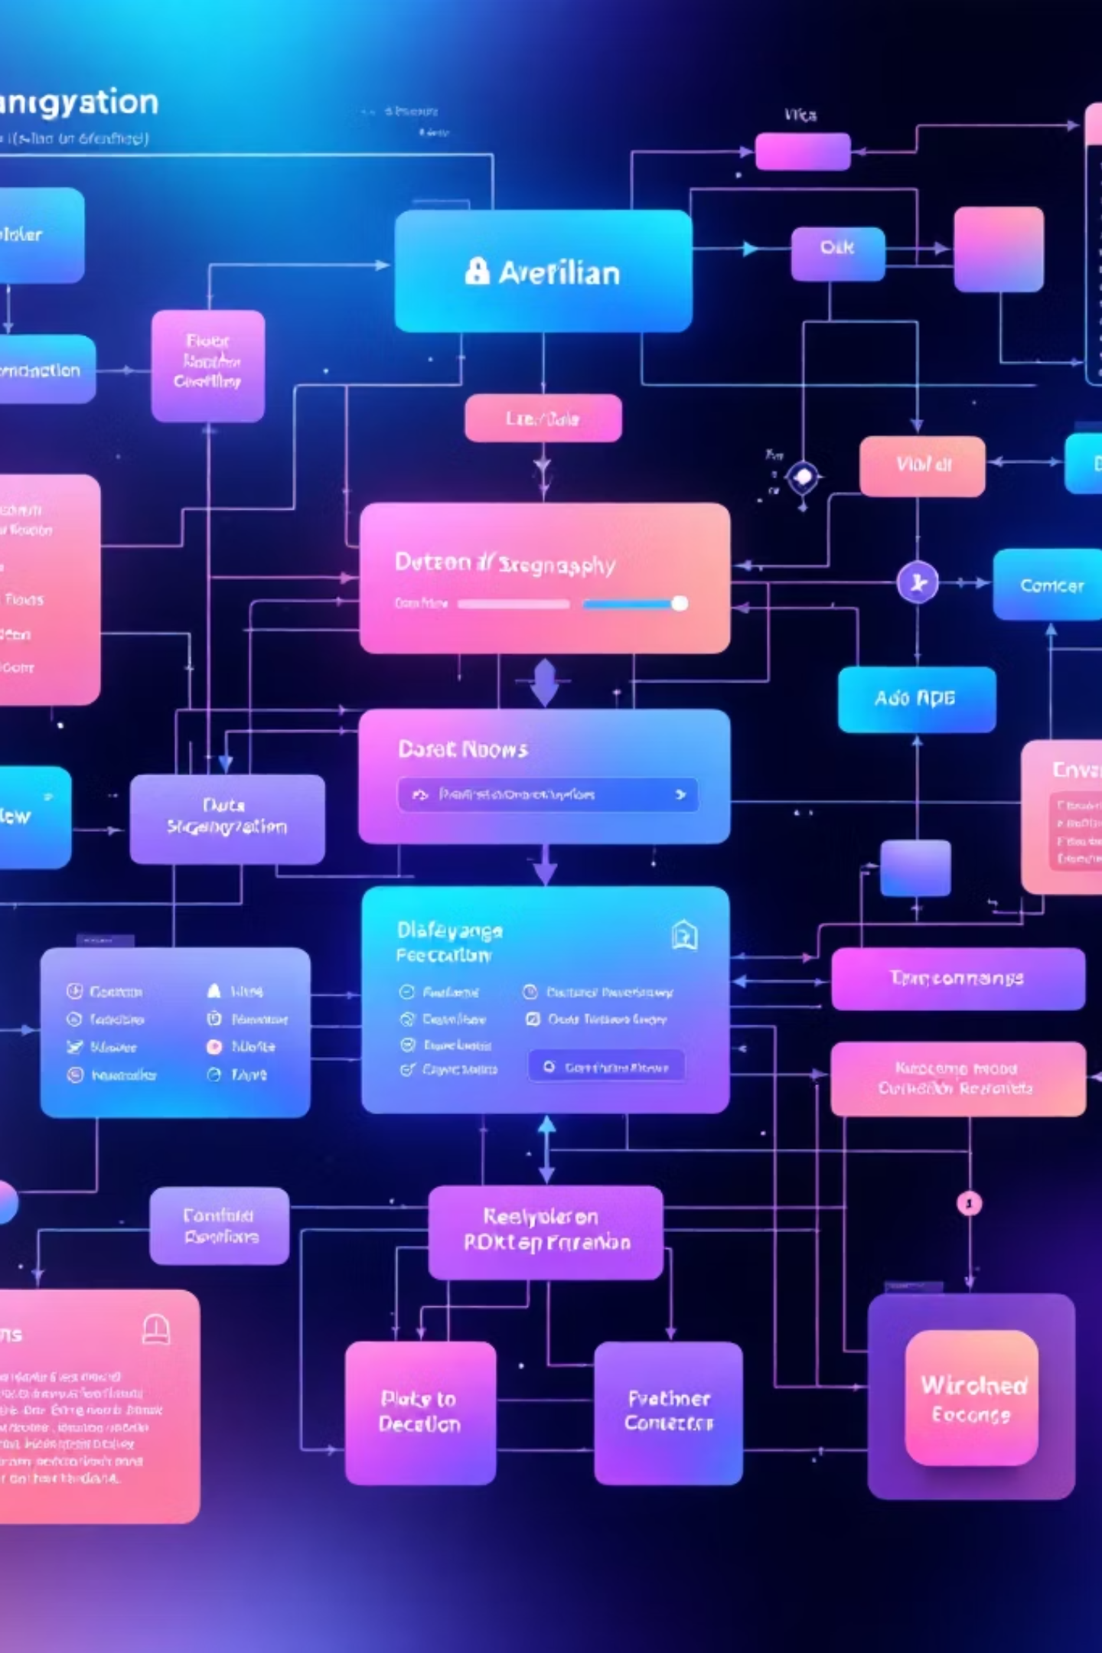




System Architecture
Input
Receive cover image & secret message
Encoding
Embed message into image LSBs
Stego Image
Output image with hidden data
Decoding
Extract & reconstruct original message
Prepared and Presented By
Sreeraj Rajeevan - 1262241335

Slide 8




Technology Stack
Python
High-level interface & automation
C++
Optimized LSB embedding & extraction
Key Libraries & Tools
Pillow (PIL) – Image file I/O & processing
OpenCV (C++) – Advanced pixel-level operations
Visual Studio Code – Integrated development environment
Core Concept
LSB substitution for imperceptible data hiding in images.
Prepared and Presented By
Sreeraj Rajeevan - 1262241335

Slide 9

Literature Review
Sr. No. | Reference Paper Title with Details | Methodology | Challenges / Scope of Improvements
1 | Johnson, N. F., & Jajodia, S. (1998). Exploring Steganography: Seeing the Unseen. IEEE Computer, 31(2), 26–34. | Explains fundamental concepts of steganography, including spatial and transform domain techniques, with focus on Least Significant Bit (LSB) substitution for images. | Lacks adaptive algorithms; vulnerable to image compression and noise.
2 | Provos, N., & Honeyman, P. (2003). Hide and Seek: An Introduction to Steganography. IEEE Security & Privacy, 1(3), 32–44. | Discusses practical image steganography systems and analyzes strengths and weaknesses of LSB and transform domain methods. | Need for higher capacity and robustness against steganalysis.
3 | Kadhim, I., Premaratne, P., Vial, P., & Halloran, B. (2019). Comprehensive Survey of Image Steganography: Techniques, Evaluations, and Trends. IEEE Access, 7, 1–35. | Provides a comparative study of modern steganography techniques (LSB, DCT, DWT). Highlights use of hybrid models and AI. | Computational cost and need for automated, intelligent embedding mechanisms.
Prepared and Presented By
Sreeraj Rajeevan - 1262241335

Slide 10









Methodology
🔐 Encoding Process
🔓 Decoding Process
Input Acquisition
Stego-Image Input
Receive text message & cover image
Load image with hidden message
Binary Conversion
LSB Extraction
Convert text to binary (ASCII)
Extract LSBs from pixel channels
LSB Substitution
Binary Reconstruction
Replace pixel LSBs with message bits
Assemble extracted bits to binary
Image Export
Message Recovery
Save stego-image (lossless format)
Convert binary to readable text
Prepared and Presented By
Adwait Bhalerao - 1262241696

Slide 11

Results and Discussion
Original Image
Stego Image
Clean cover image (cat.png)
Secret message embedded (stego_cat.png)
Experimental Results
0%
100%
Hidden Message: "Admin password: Cyber123"
Visual Impact: Imperceptible to human eye
Quality Loss
Recovery Rate
Extraction Accuracy: 100% message recovery
No degradation
Perfect message extraction
Performance: 3.2x speedup with C++ optimization
Prepared and Presented By
Adwait Bhalerao - 1262241696

Slide 12




Limitations & Future Scope
Current Limitations
Future Enhancements
Lossless Format Required
Requires lossless formats (e.g., PNG).
Hybrid Security
LSB + AES encryption.
Capacity Constraints
Message size limited by image dimensions.
Multimedia Expansion
Video & audio steganography.
Sensitive to Transformations
Resizing, cropping, conversion corrupts messages.
AI-Resistant Methods
Adaptive algorithms against steganalysis.
Prepared and Presented By
Adwait Bhalerao - 1262241696

